Slide 1

Electricity Lesson 1

Slide 2
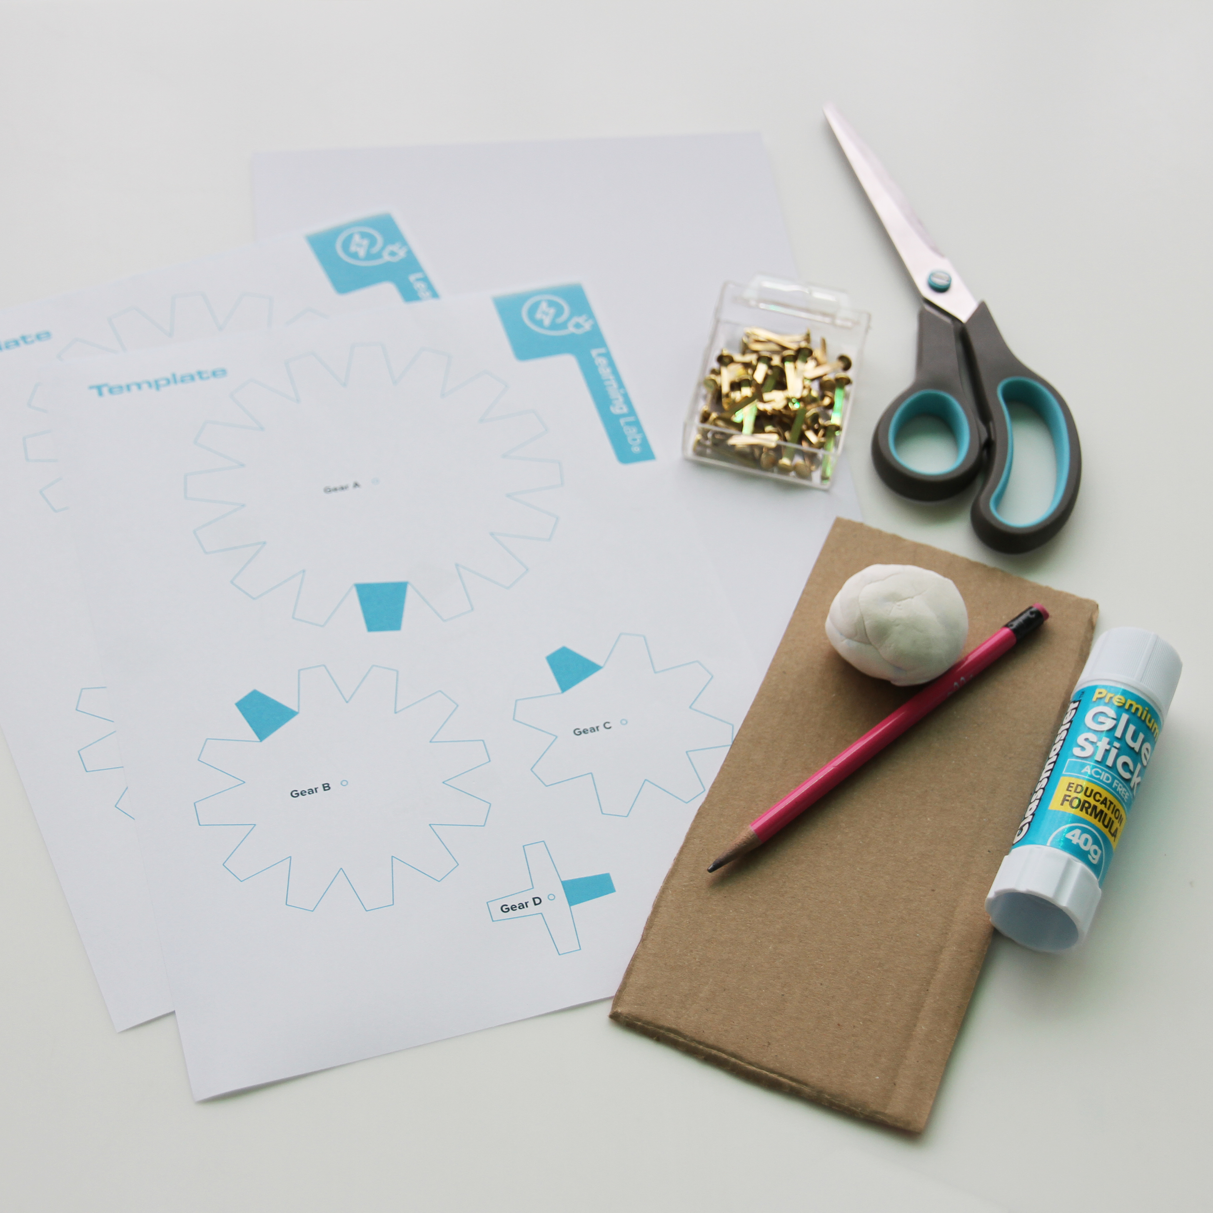
You will need
2 x Gear Template sheets
Corrugated cardboard
Scissors
Glue stick
Blu tack/plasticine
Pencil
4 x split pins
Paper

Slide 3
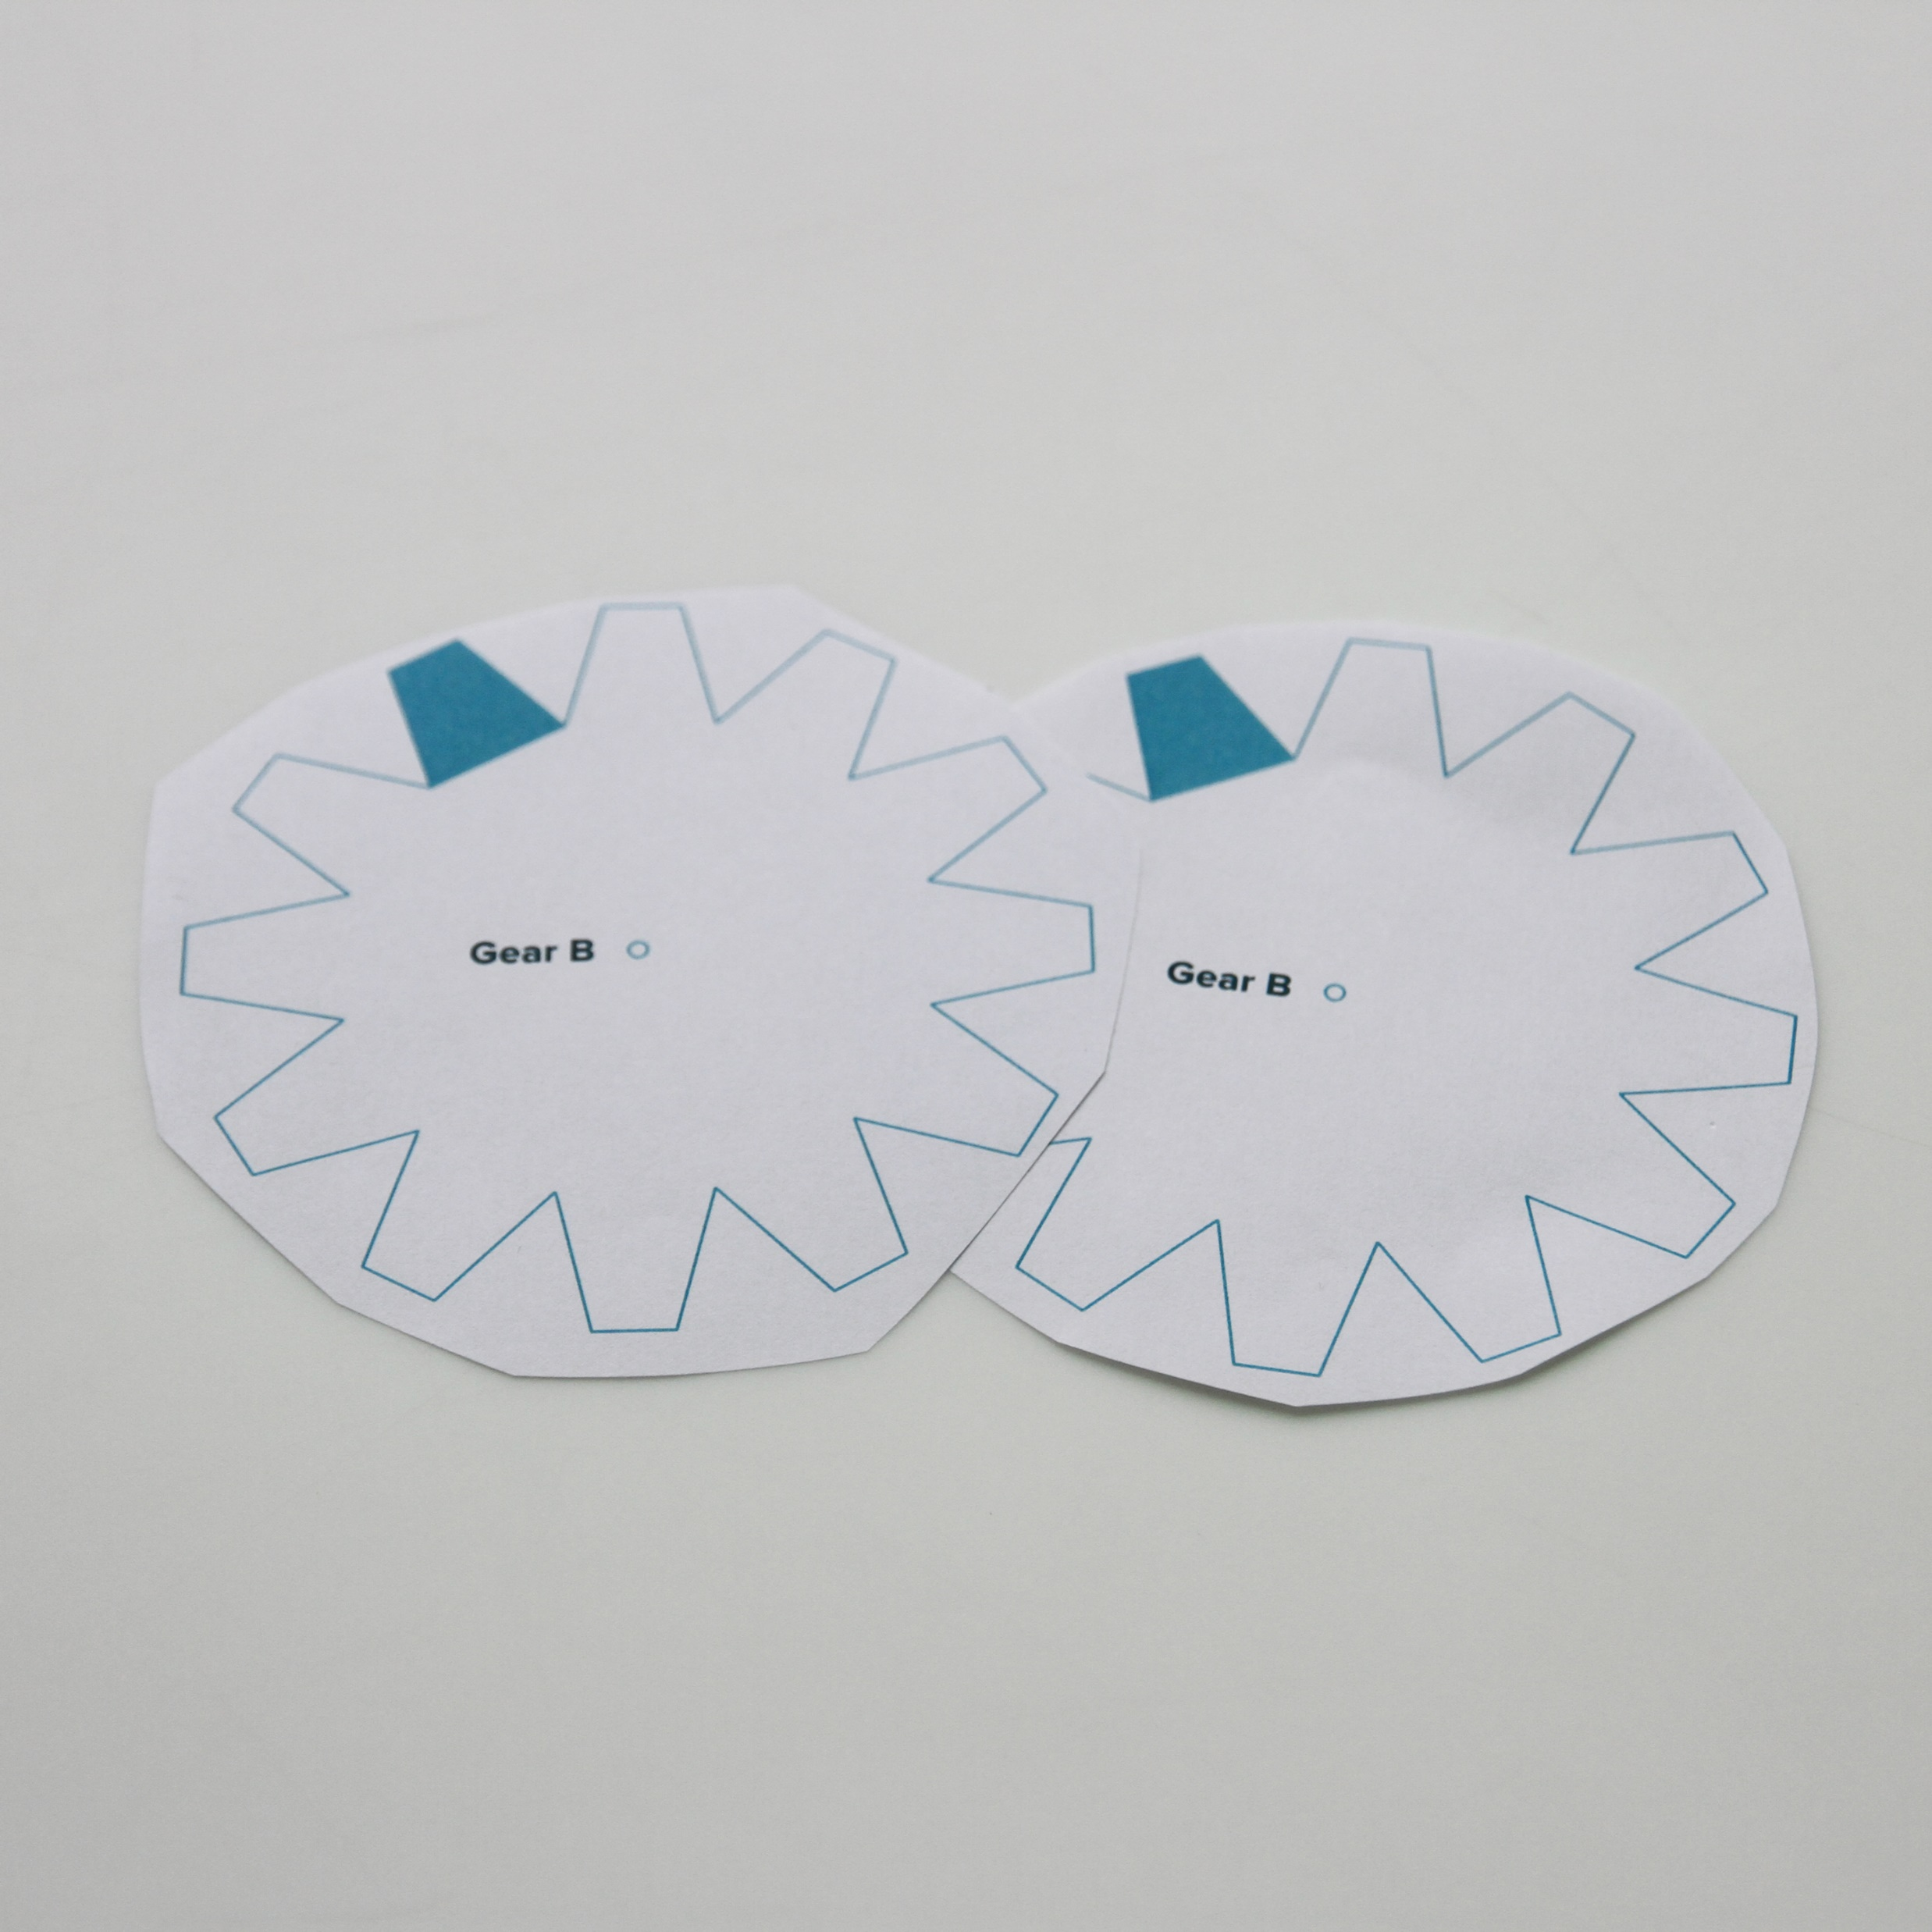
For each gear you are making, roughly cut out the template on both Gear Template sheets.

Slide 4
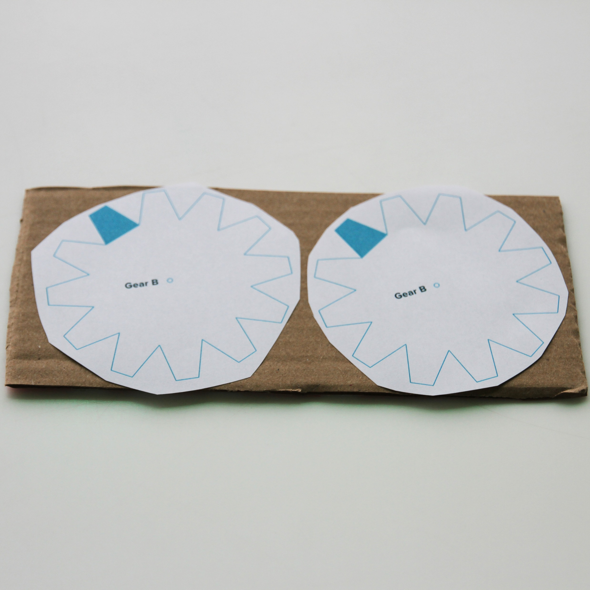
Using a glue stick, glue the gear templates onto a piece of cardboard.

Slide 5
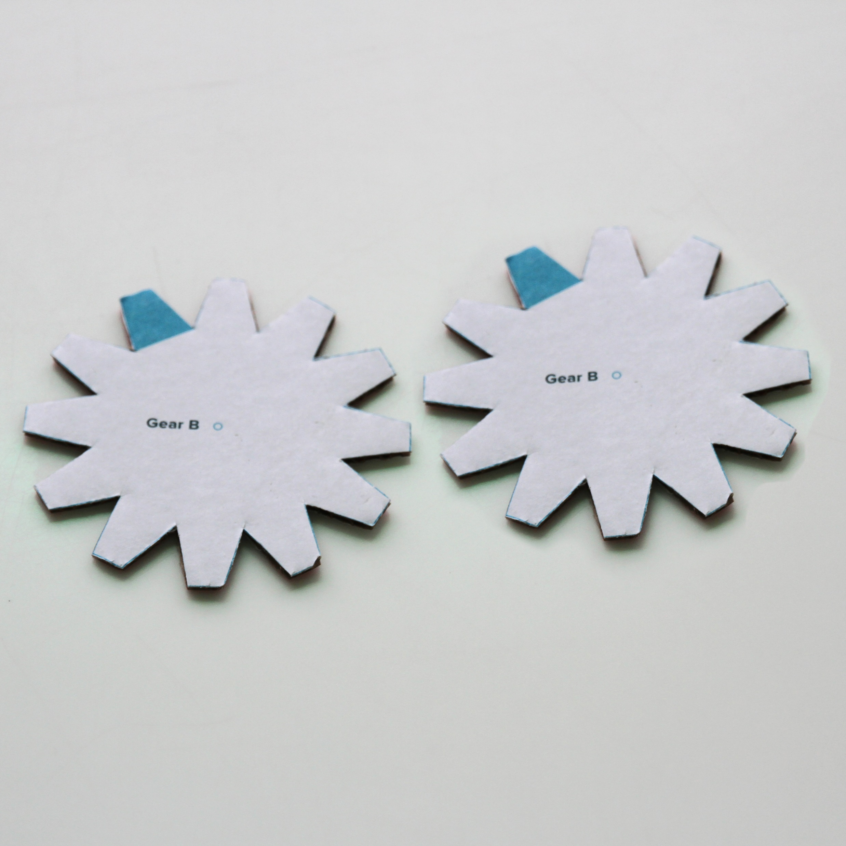
Carefully cut out the gear shapes.

Slide 6
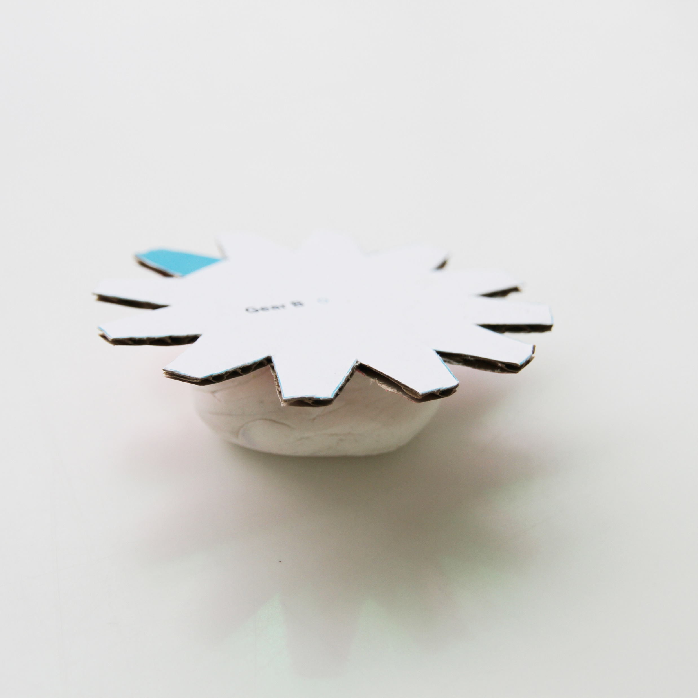
Place a ball of blu tack or plasticine on the desk. Place the centre of one gear shape on top.

Slide 7
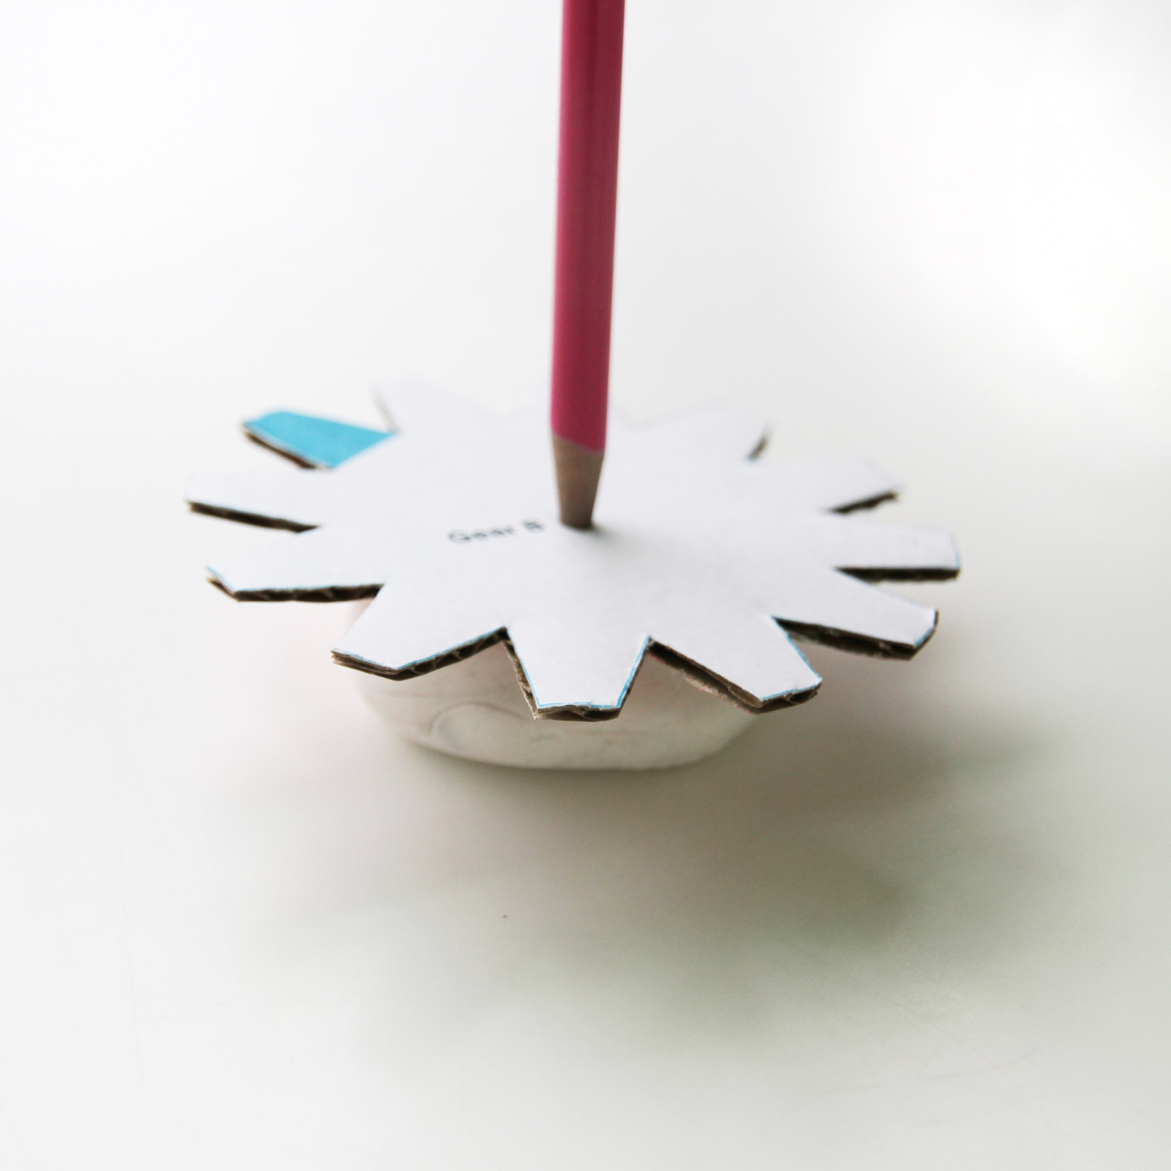
Using a pencil, make a small hole in the centre of the gear shape.
Do this for both gear shapes.

Slide 8
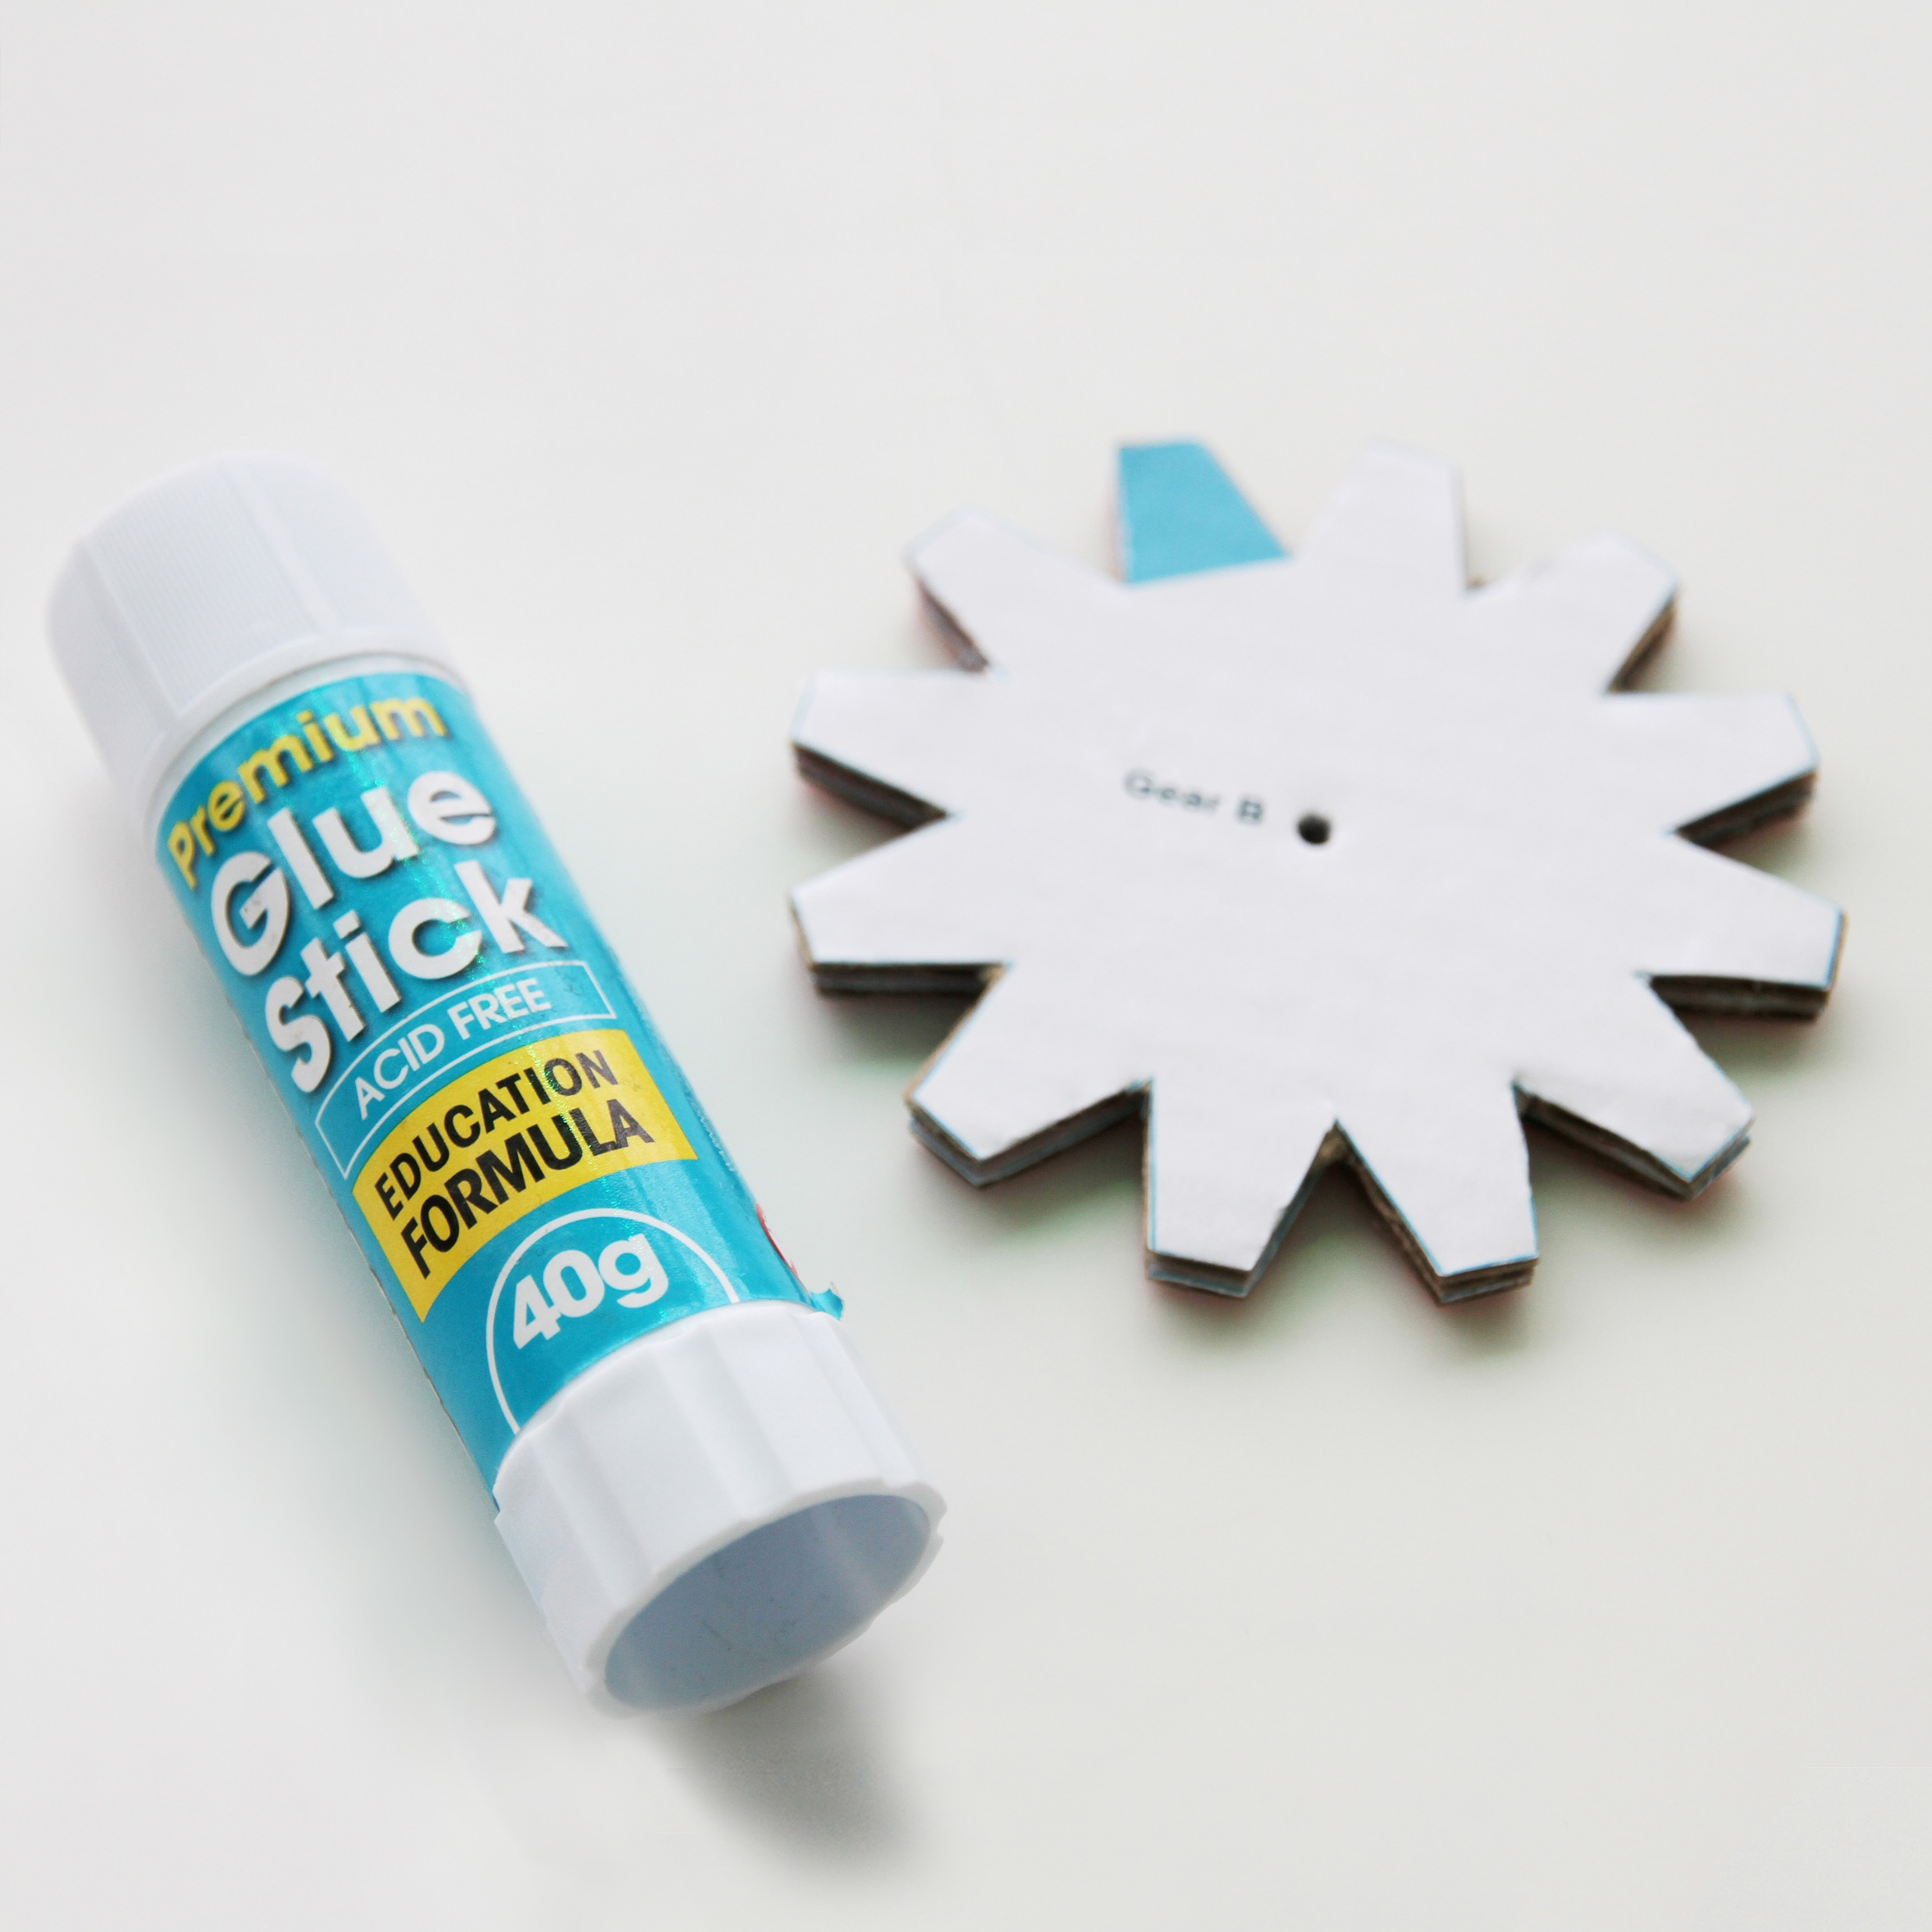
Using the glue stick, glue one gear shape on top of the other, to make one thicker gear.

Slide 9
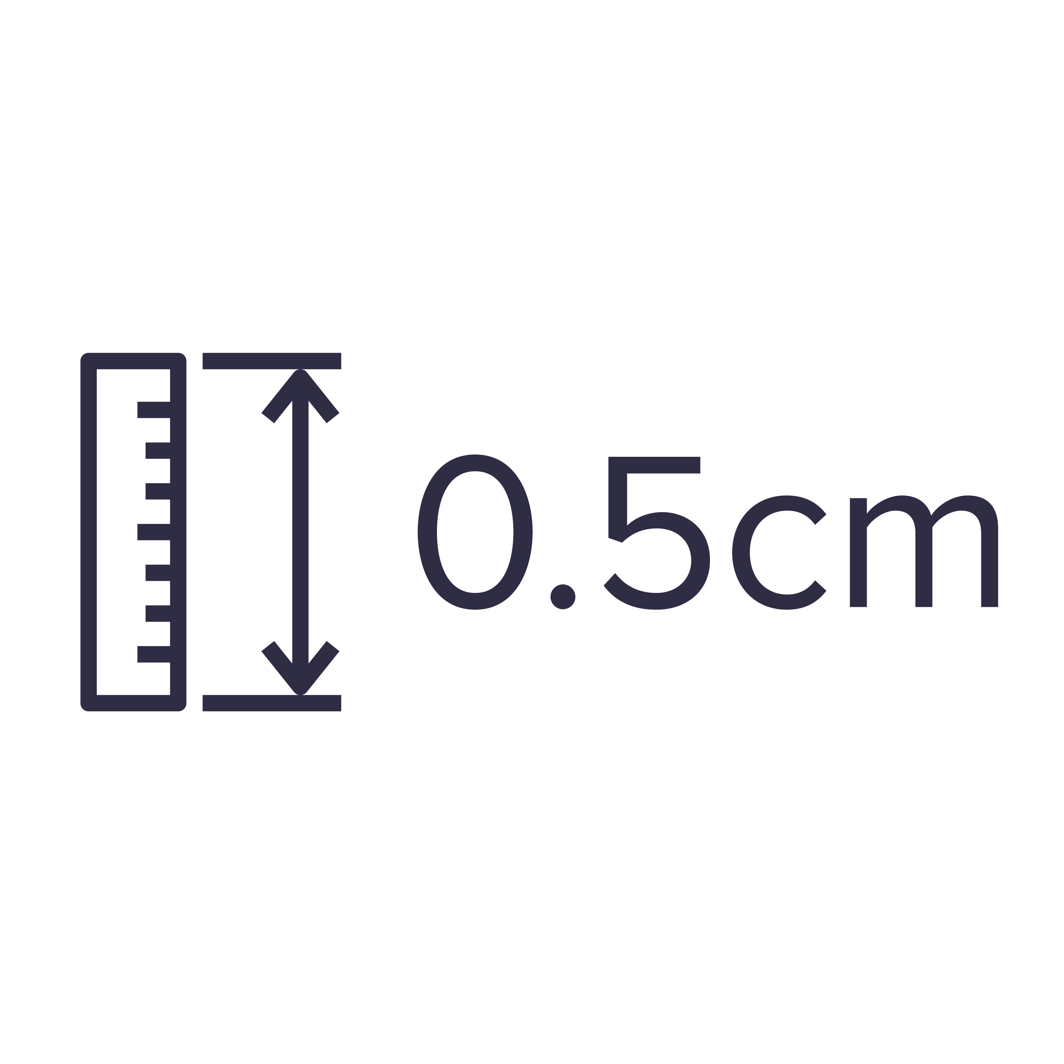
Measure the thickness of the gear. It should be at least half a centimetre thick.
If it's not thick enough, another layer will be needed.

Slide 10
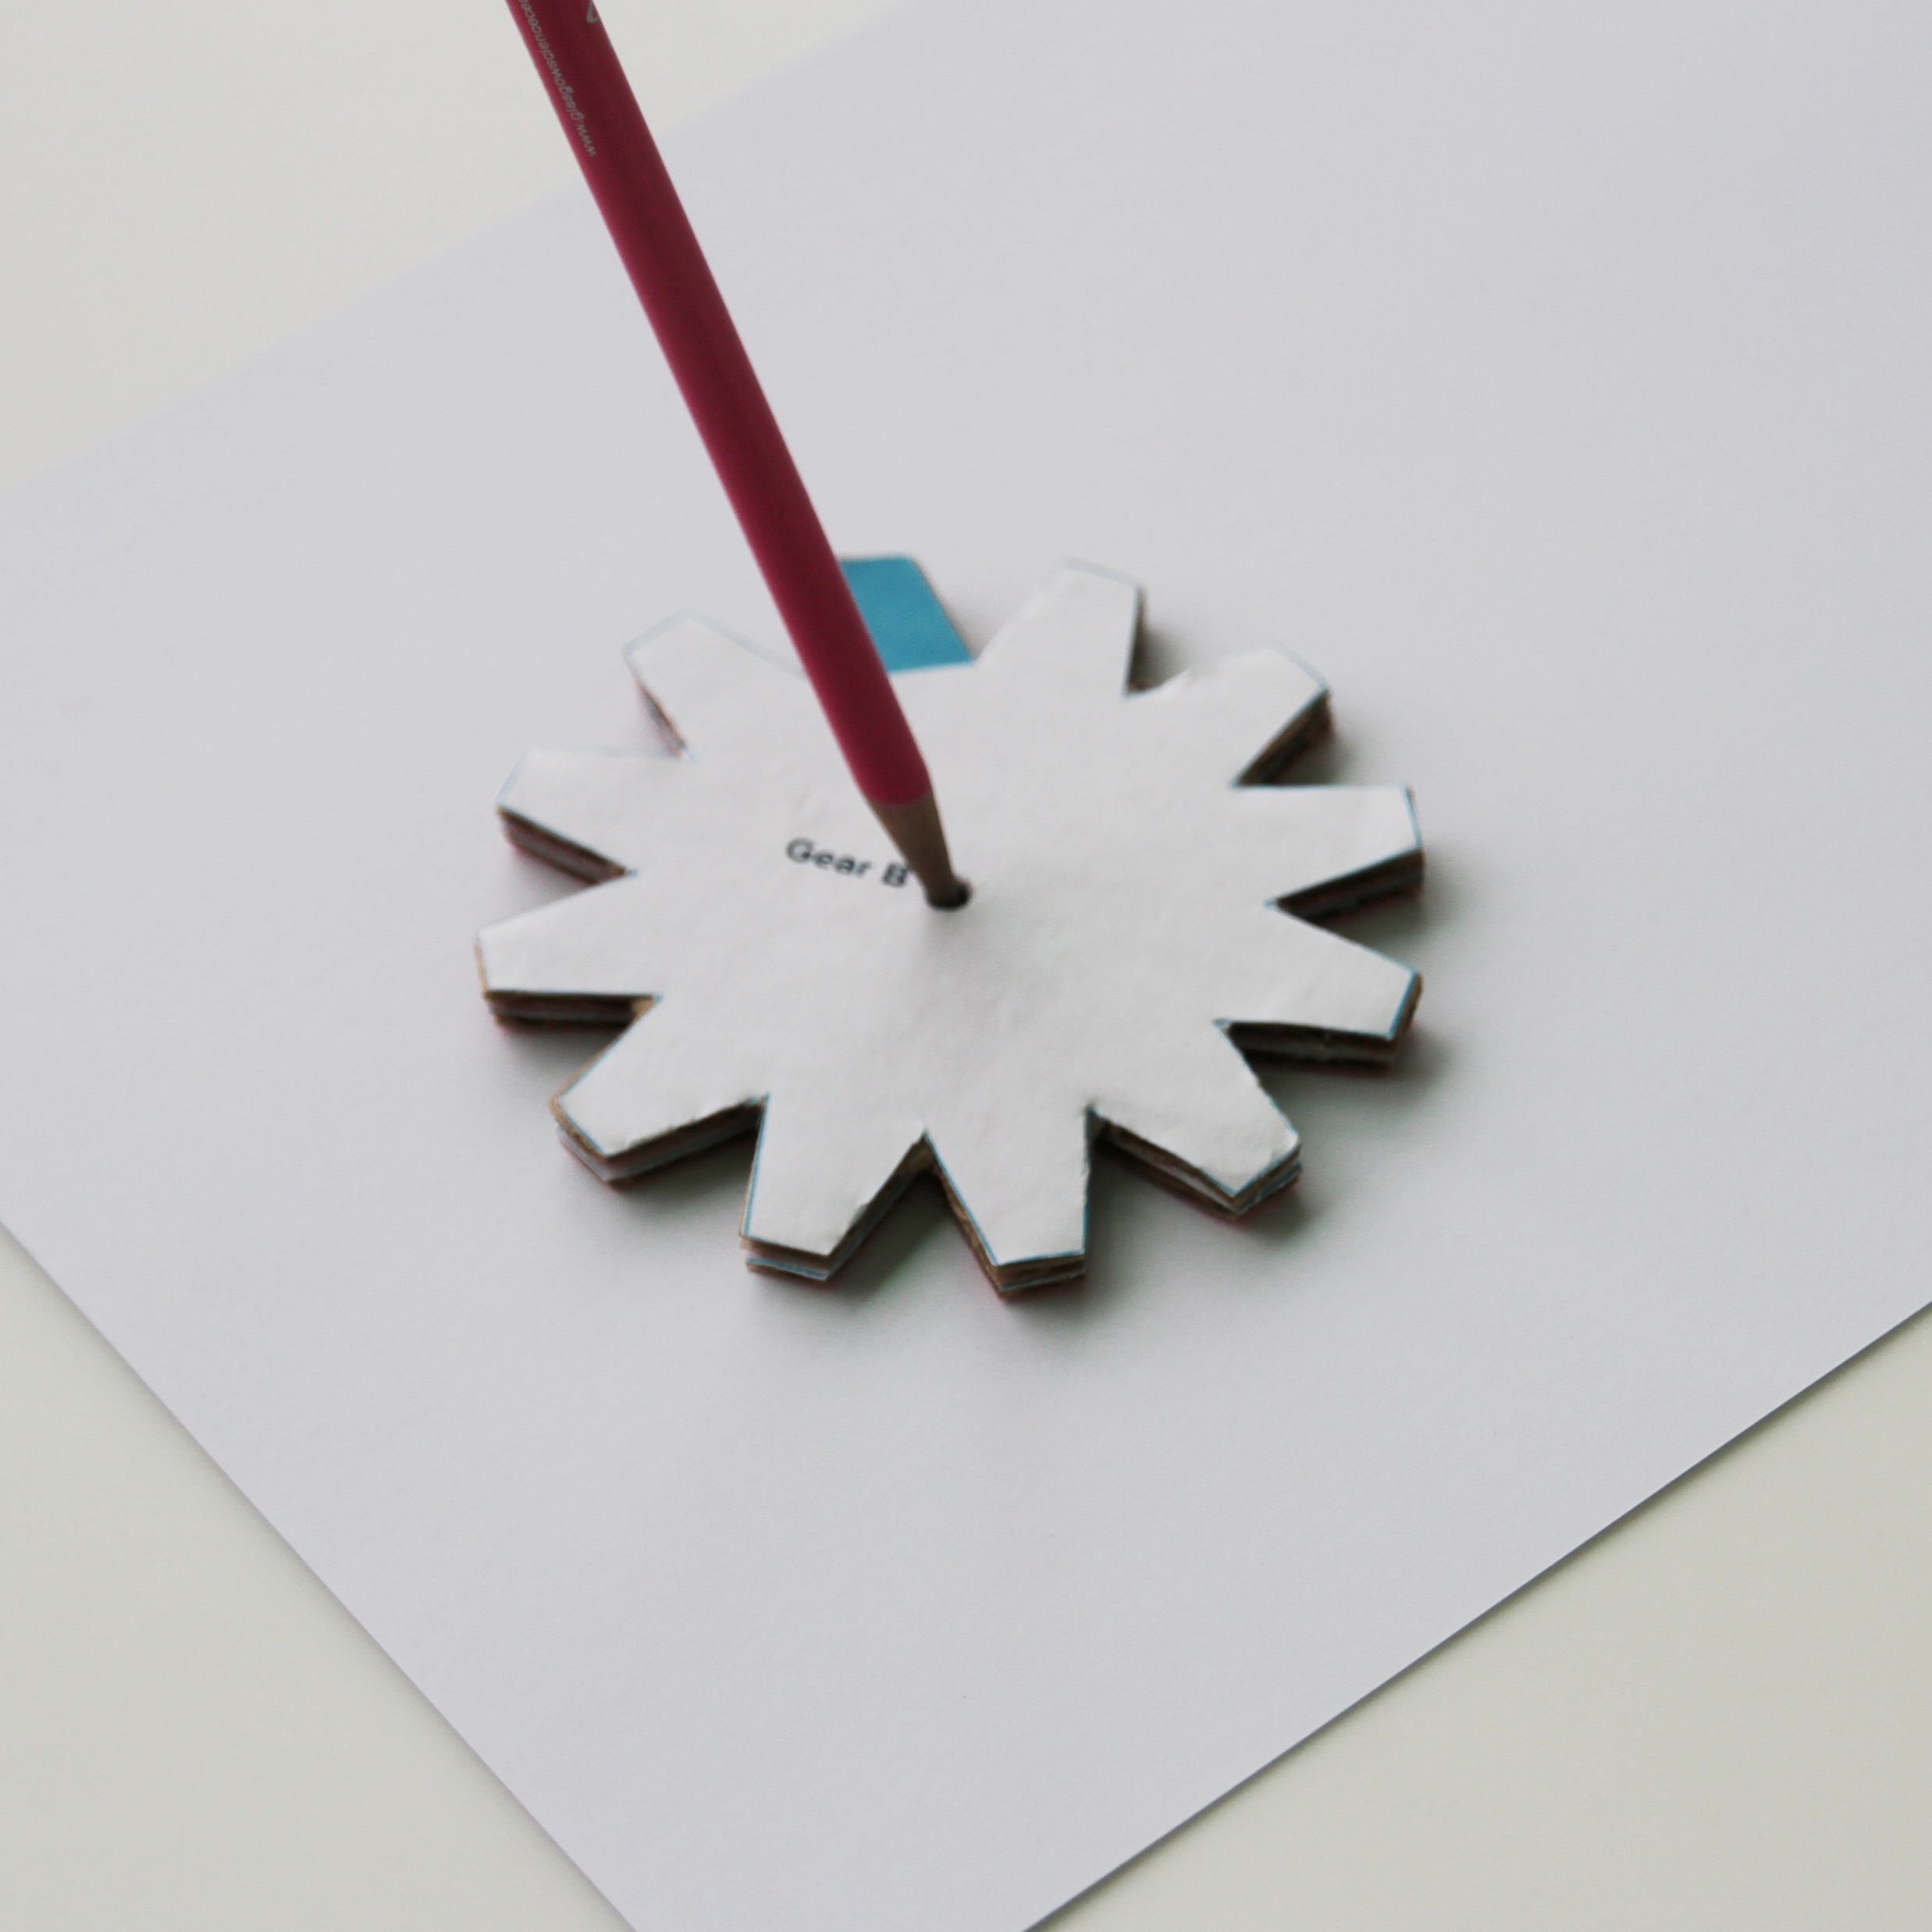
Place the gear onto a piece of paper. Use a pencil to make a mark through the hole.

Slide 11
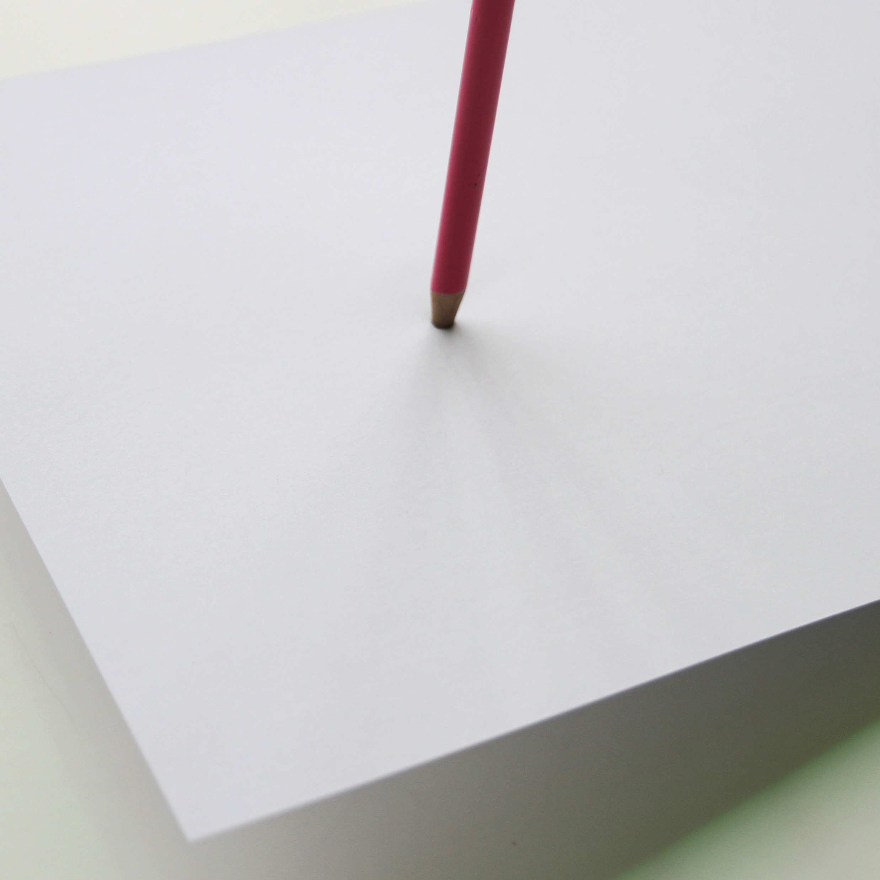
Place a ball of blu tack or plasticine on the desk.
Place the mark on the paper over this and use a pencil to make a hole.

Slide 12
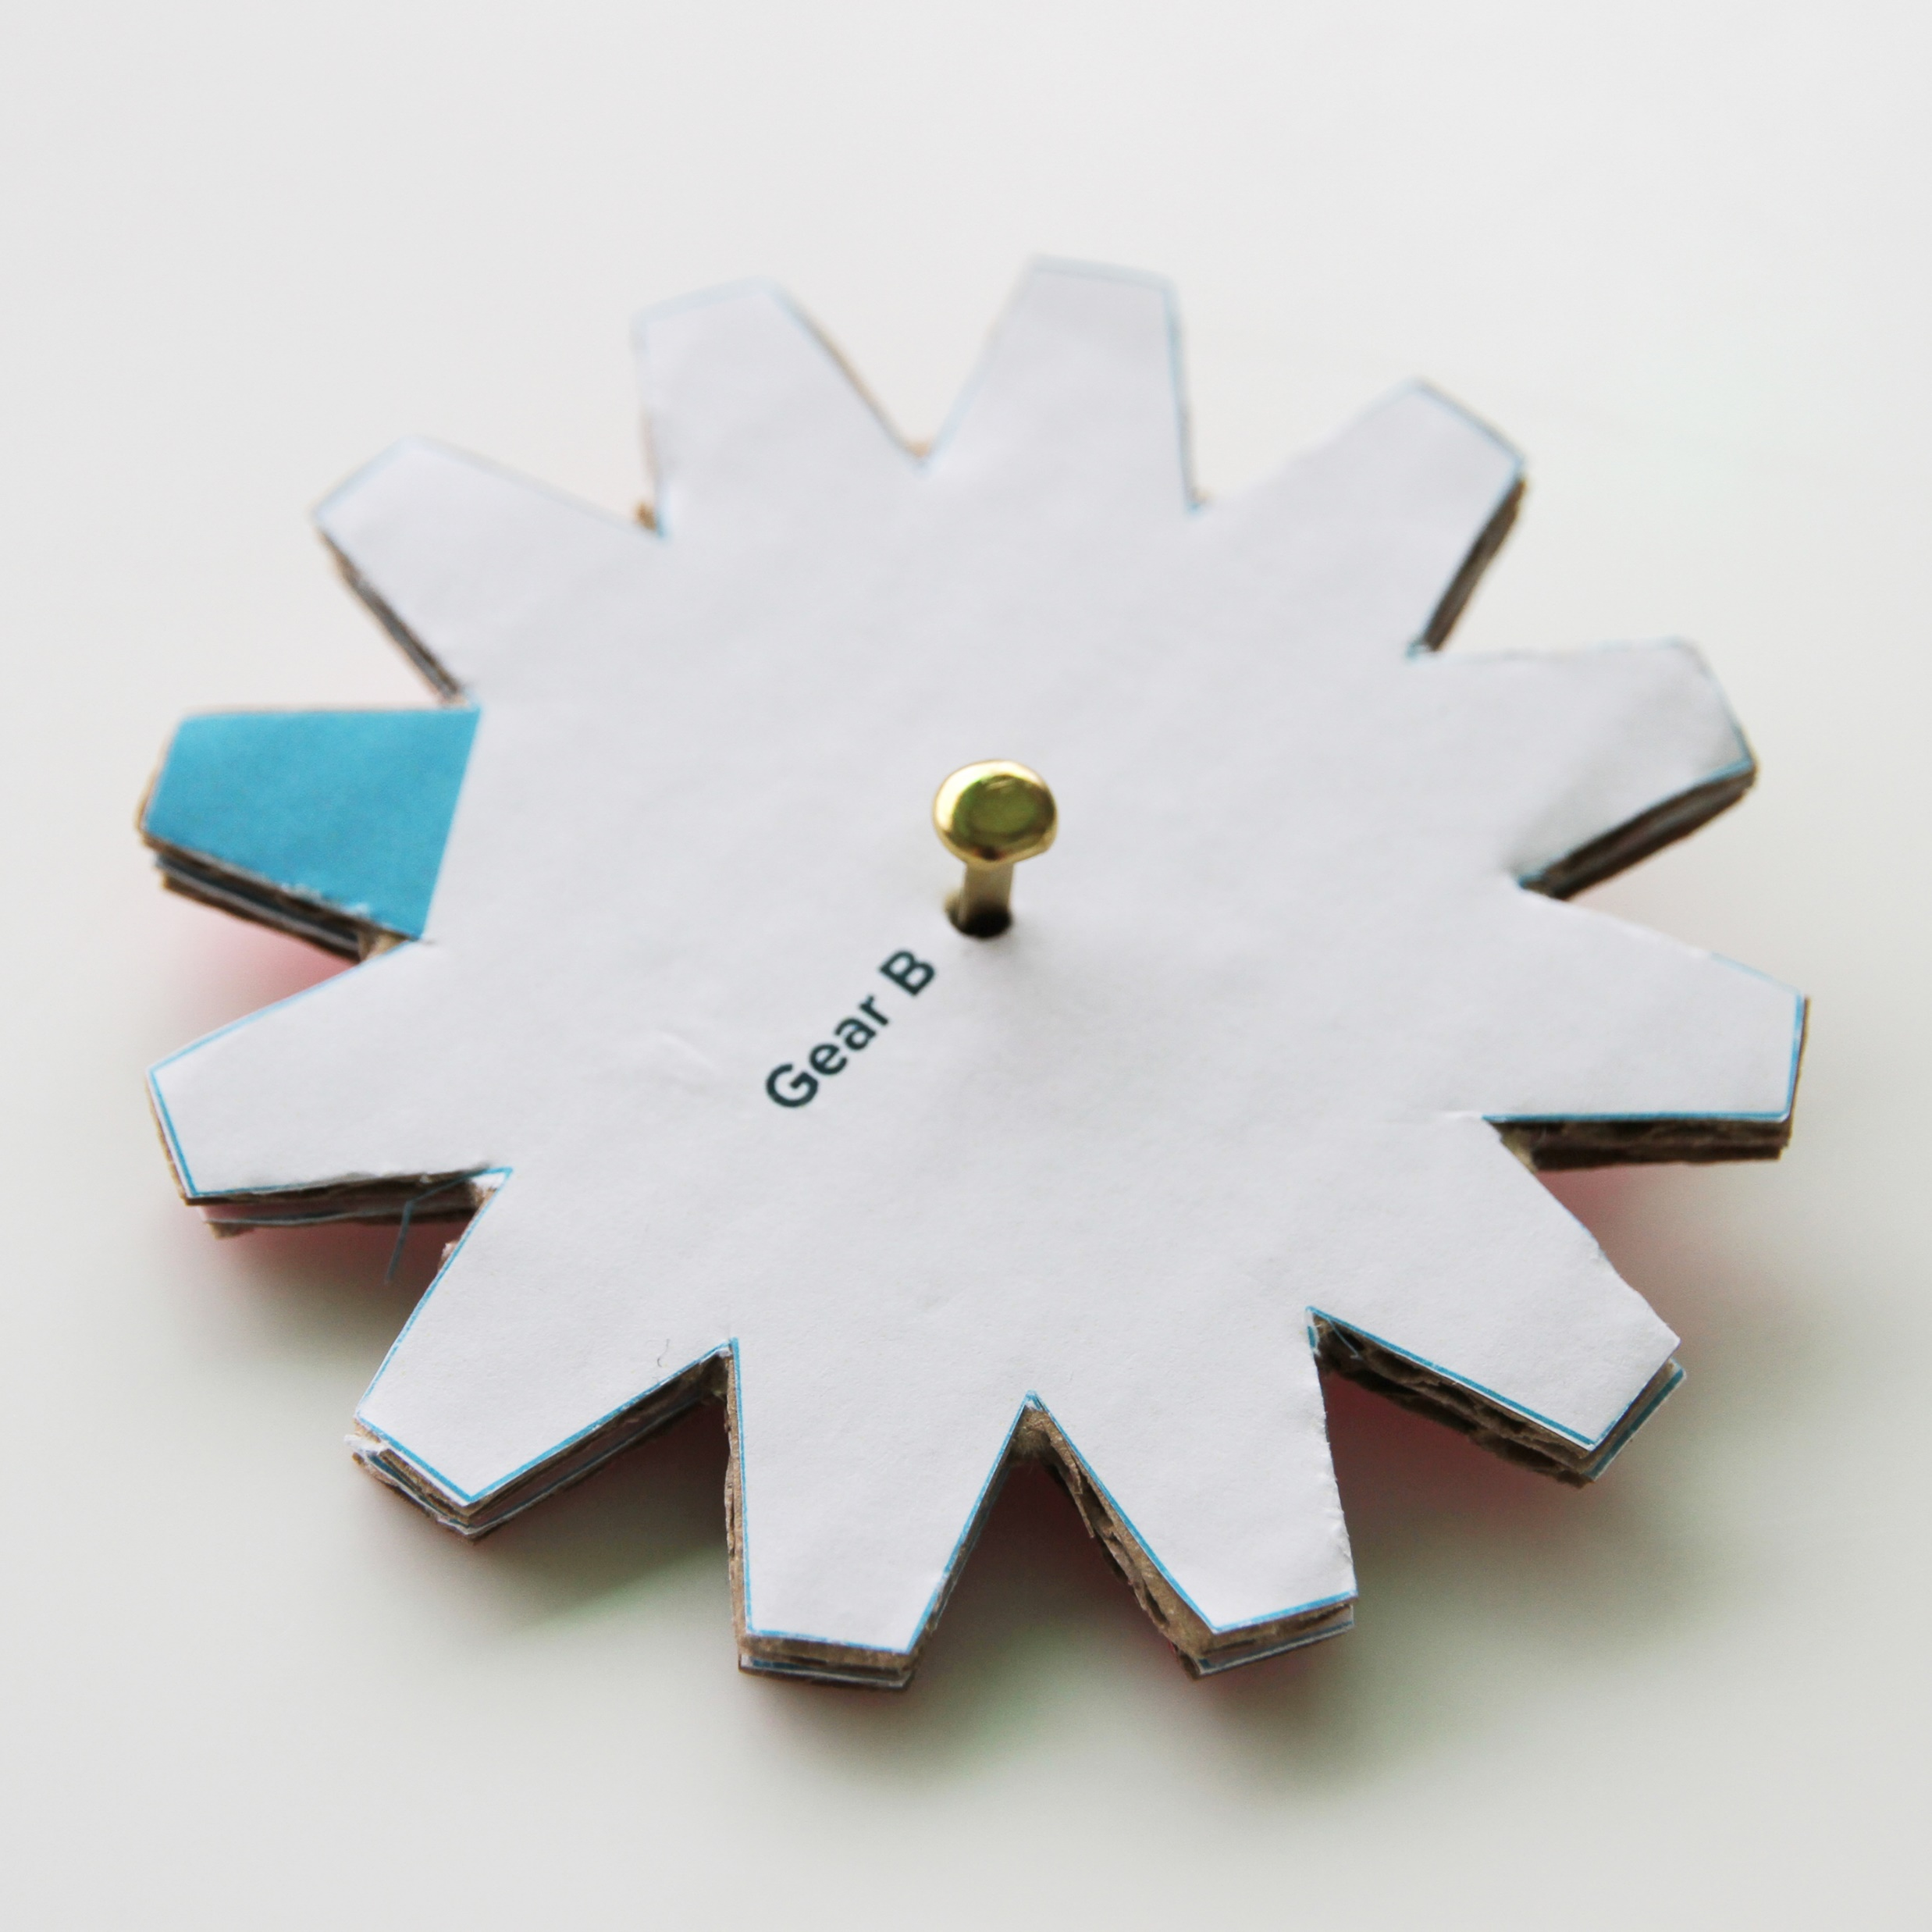
Push a split pin through the gear and hole in the paper.

Slide 13
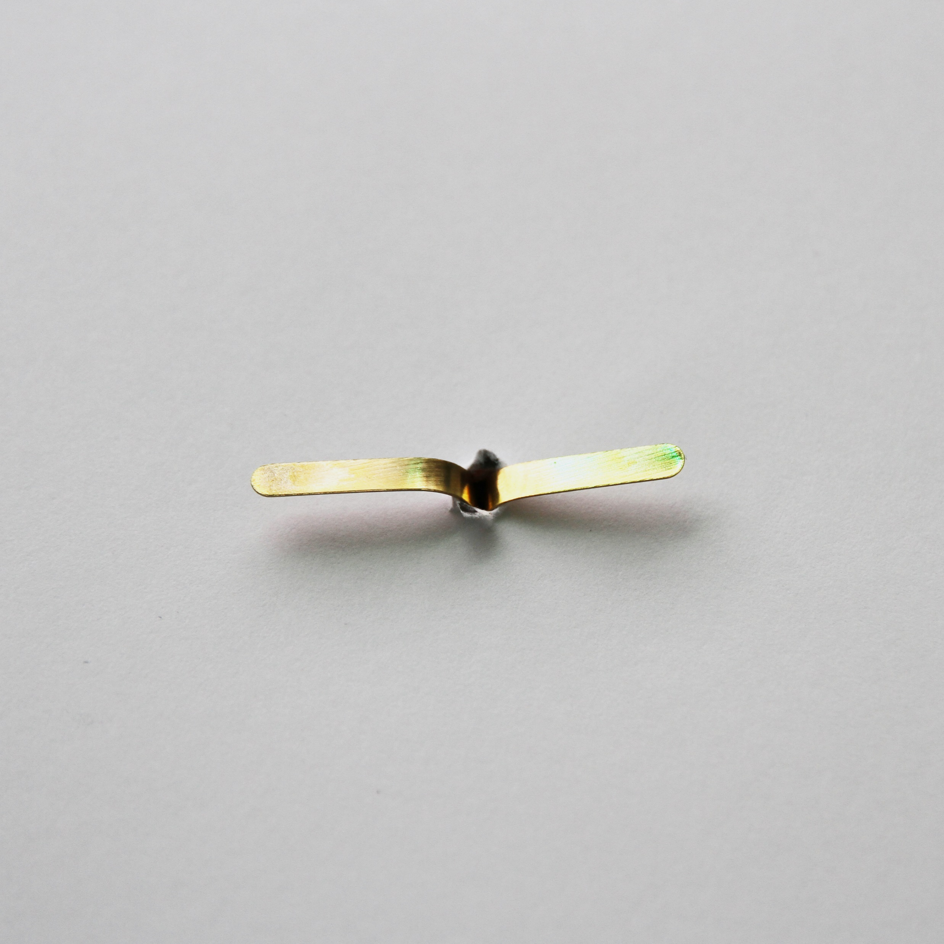
Secure the gear by bending back the legs of the split pin.

Slide 14
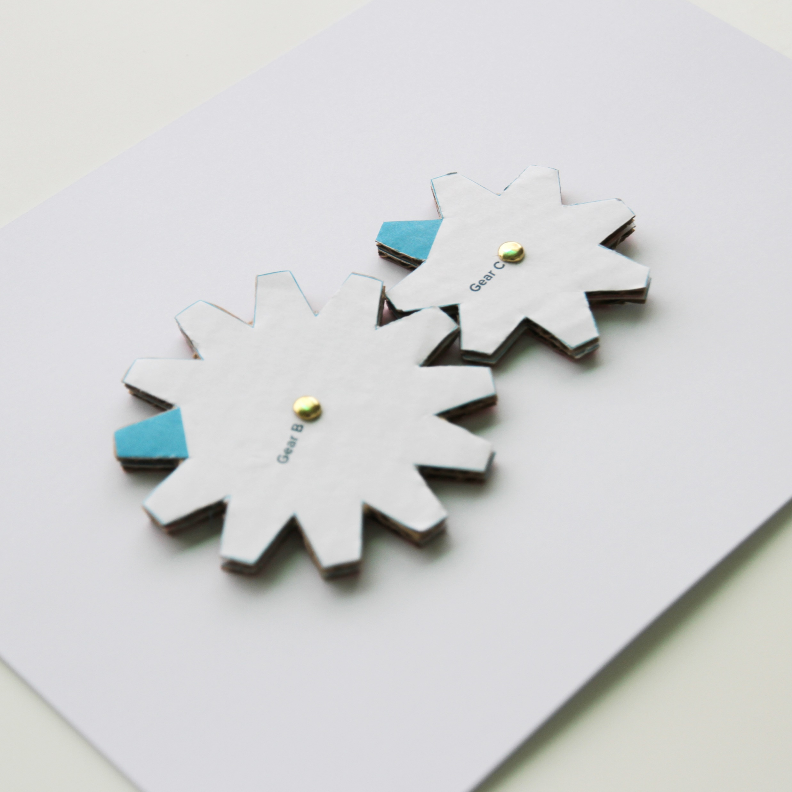
To use gears together, make sure the teeth of the gears interlock and rotate.

