Slide 1
Teacher Instructions
The activity can be run either as:
A teacher-led activity with one or two sets of soil pots. In this case the instructions are for your reference only.
An individual activity with each pupil setting up and maintaining their own soil pots.
A group activity where the recommended maximum group size is 4.

Slide 2

Teacher Instructions
Note: This lesson needs to be set up and left for at least two weeks before the worksheet can be used.

Slide 3
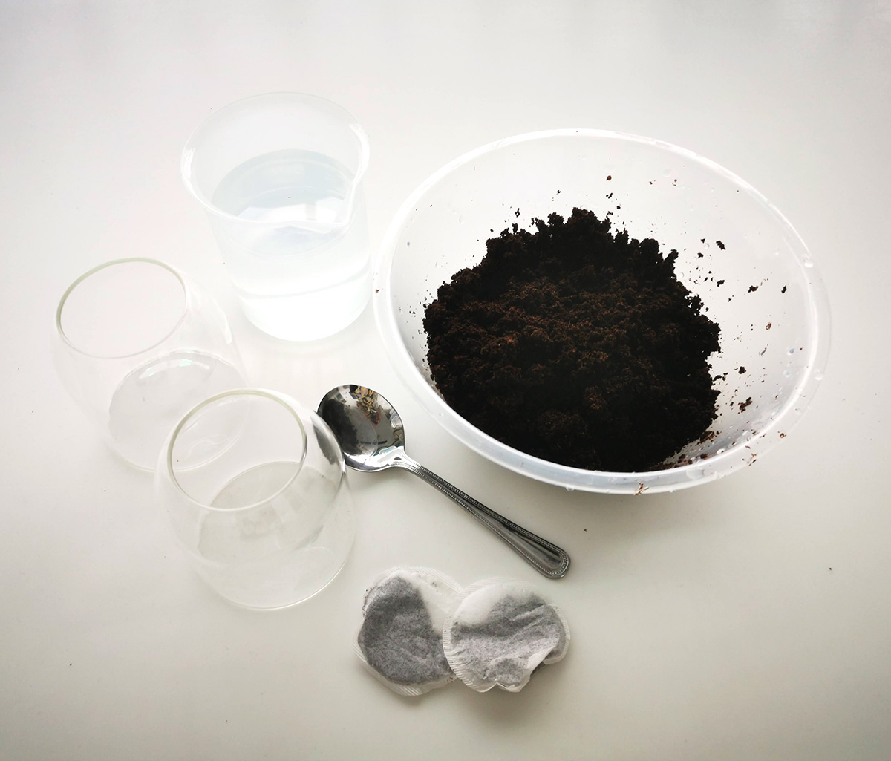
Teacher Instructions
Resources per set of soil pots
2 x medium pots or jars (e.g. empty jam jars)
Soil
Spoon or scoop
2 x green tea teabags
Water

Slide 4
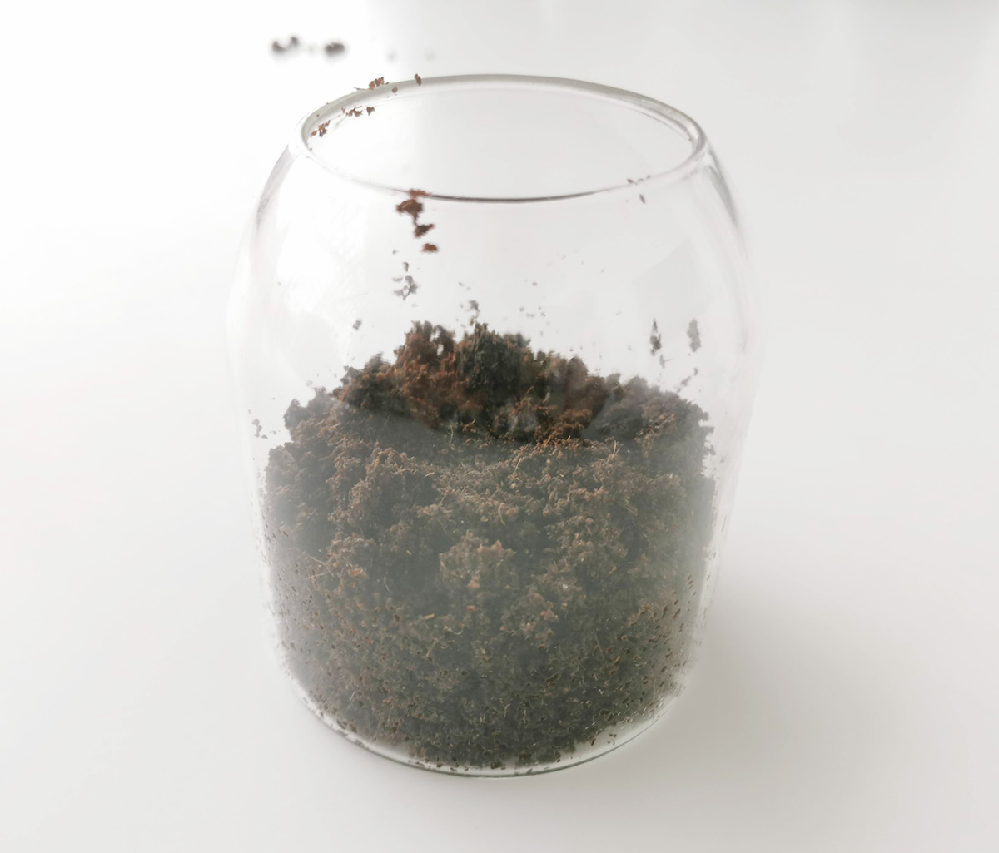
Set Up Instructions
In each jar or pot, scoop enough soil to create a layer about 5 centimetres deep.

Slide 5
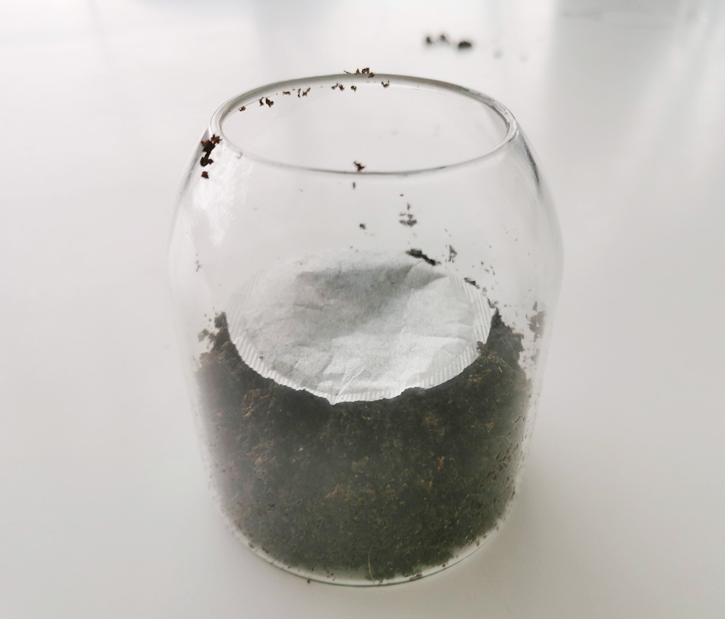
Place a teabag flat on top of the soil.

Slide 6
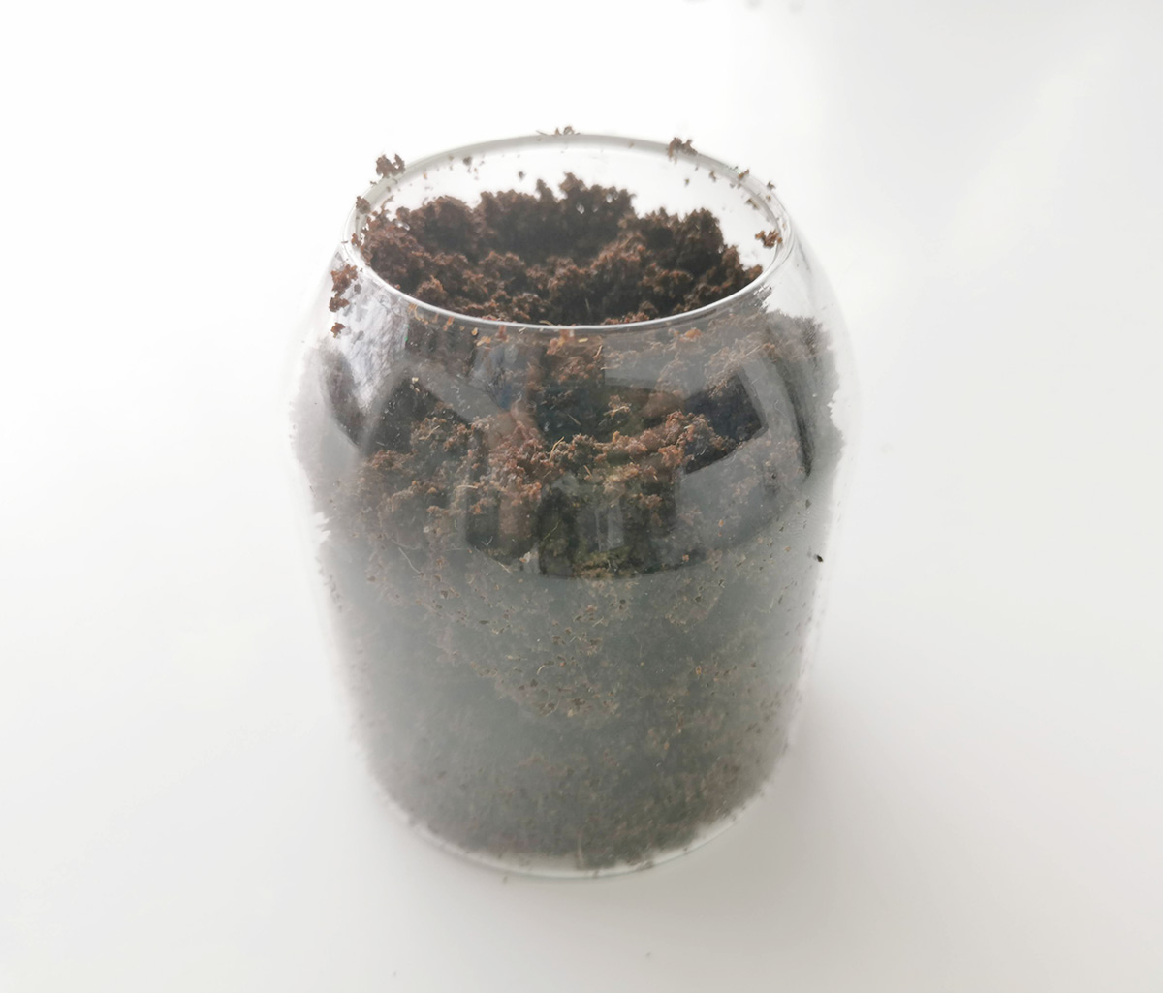
Cover the teabag with another 5 centimetre layer of soil.

Slide 7
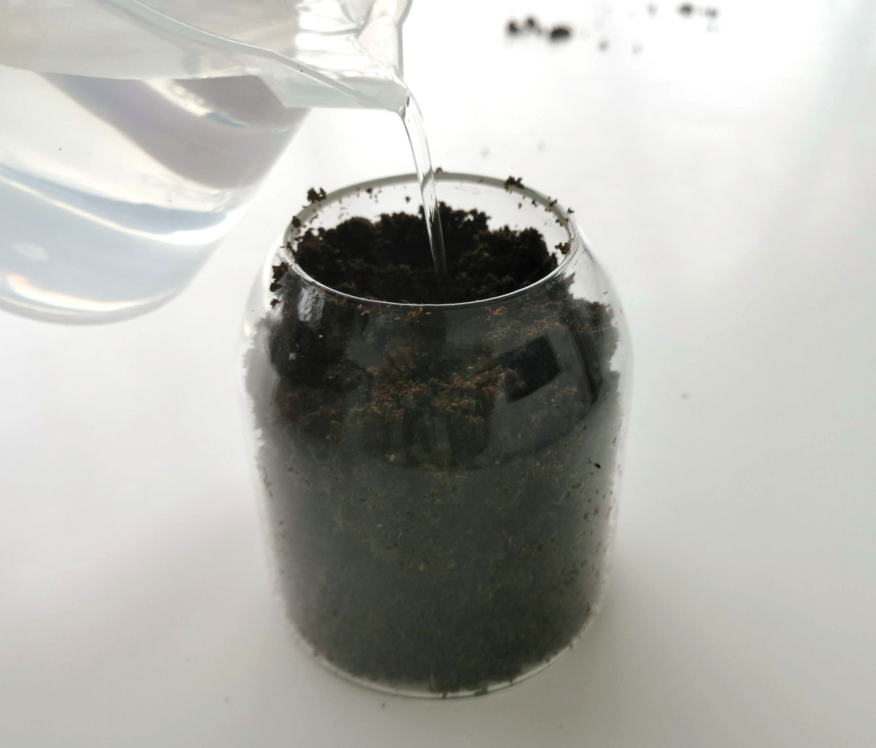
Into one pot, add a small amount of water.
This should be just enough to make the soil slightly damp, not soaking wet.
This is the damp soil.

Slide 8
Into the other pot, you're going to make waterlogged soil.
Add a small amount of water, and wait for it to soak into the soil.

Slide 9
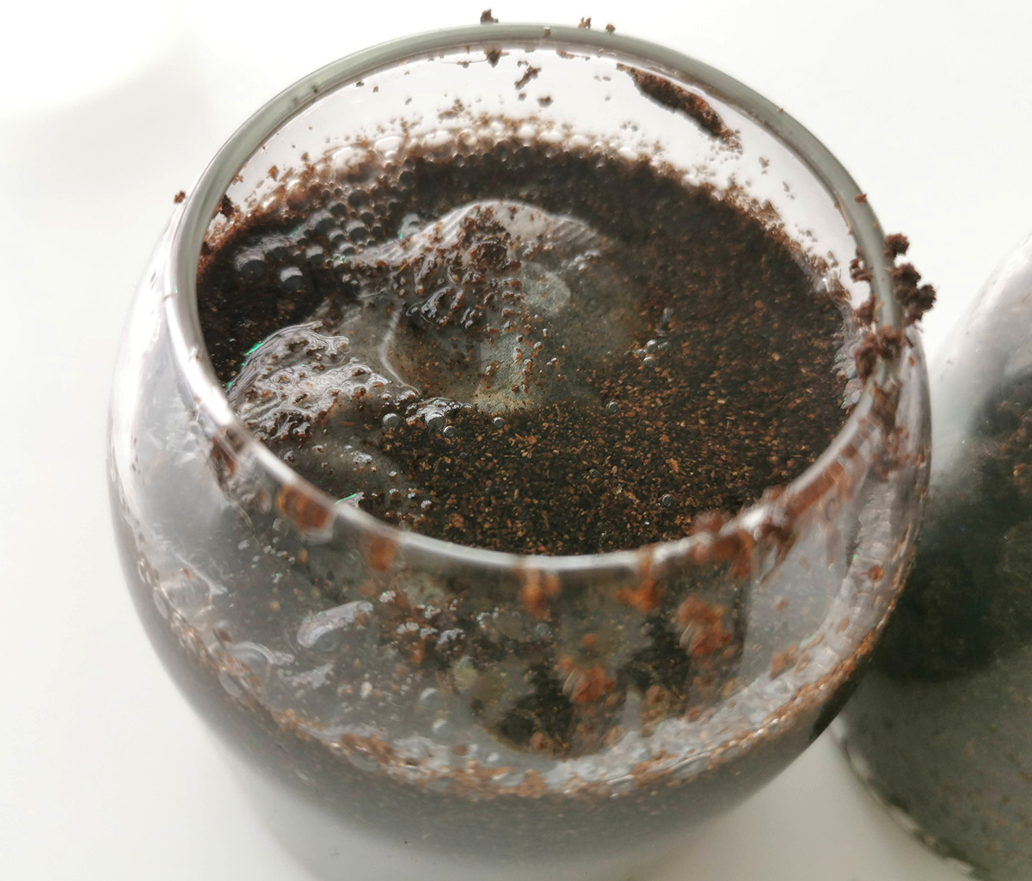
Keep adding small amounts of water, letting it drain into the soil.
Stop adding water once the soil is completely soaked.
Don't add too much water, because this will cause the teabag to float.
If that happens, drain away some water and bury the teabag into the soil.

Slide 10
During the investigation, you're going to keep both pots at the correct water level.
If either pot looks like it's drying out, add a small amount of water.
On most days, they won't need extra water.

Slide 11
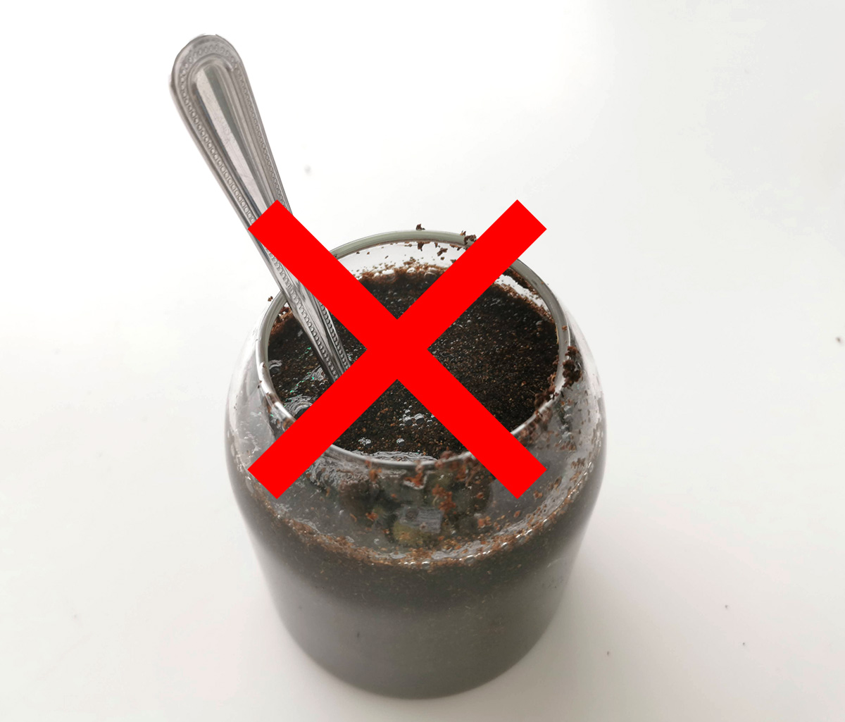
Don't stir the soil in the pots during the investigation.
If too much water is added to the waterlogged soil once the investigation has started, the teabag could float.
If this happens, let it continue to float, and don't bury it.

Slide 12
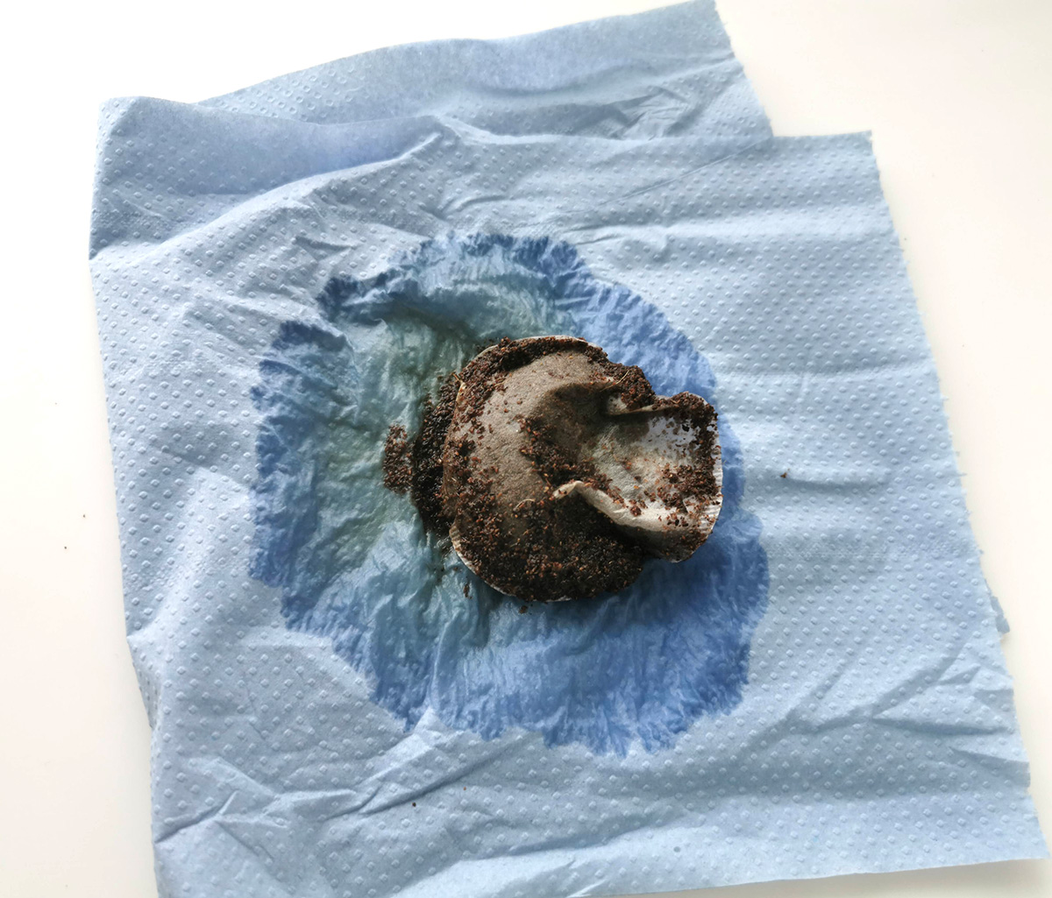
After at least two weeks, the teabags will be ready to look at.
Carefully dig out both teabags. You may wish to very gently rinse any soil away.
Lay them on a paper towel.
Complete Worksheet 1 – Tea Testing.

Slide 13
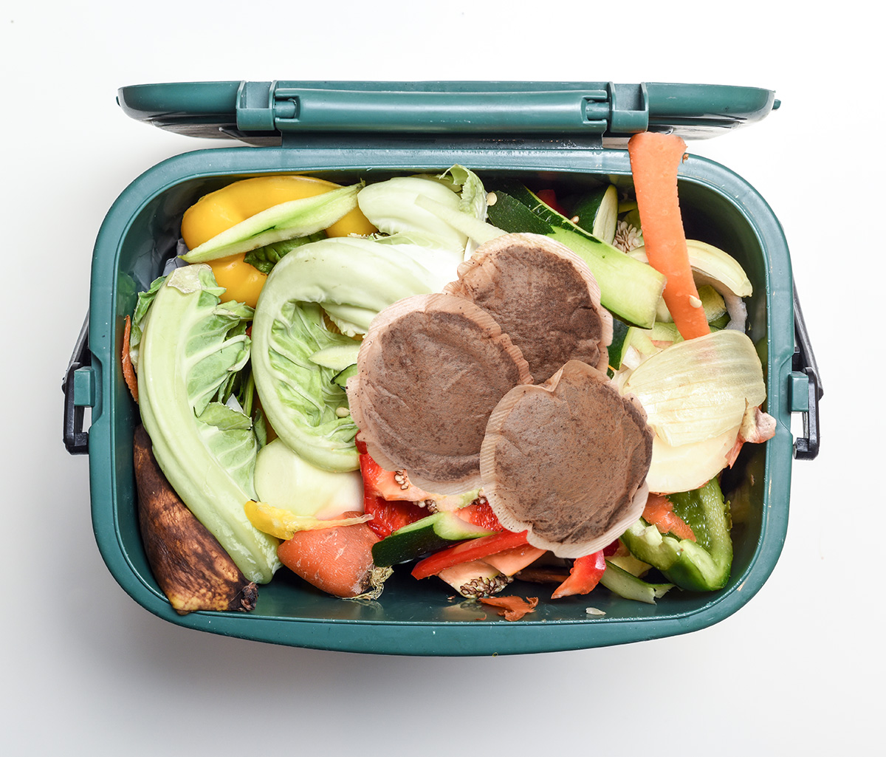
Tidying up
Place tea bags in a food waste bin.
Soil can be reused for potting plants, after excess water has been drained and the soil has been stirred.
Rinse the pots, and reuse or recycle.

